Slide 1

Research Progress Record
Enmao Diao
Jun 25, 2020

Slide 2
Overview
Code reorganizing ongoing, multi-GPU support validated
Smart Turbulence
Preliminary Exam

Slide 3
Multimodal Controller for Generative Models
Paper submitted to NeurlPS
To Do Before Rebuttal
Reorganize my code and add multi-GPU support for MC
Decrease the variance in training VAE and Glow by fine tuning better optimization procedure
Fine tune a better architecture for MCGAN to generate ImageNet CelebA (identity). Previously Discriminator Loss too high
Multimodal controlled normalization (MCNorm based on GroupNorm)

Slide 4
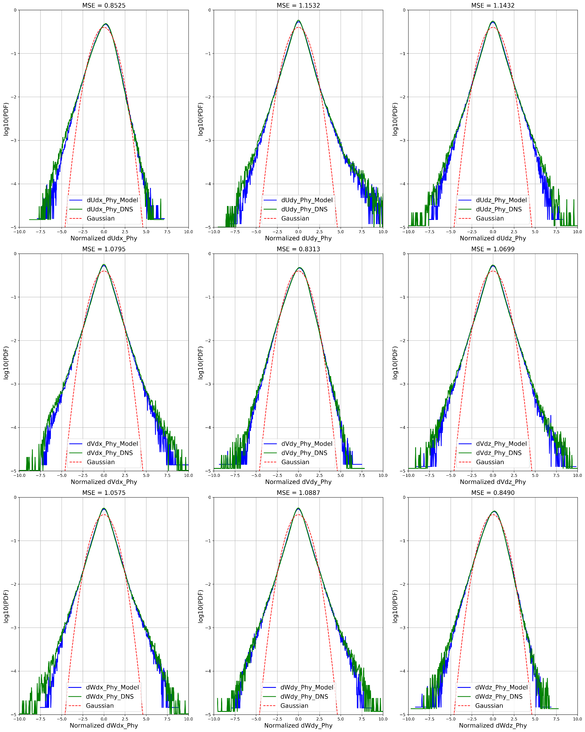
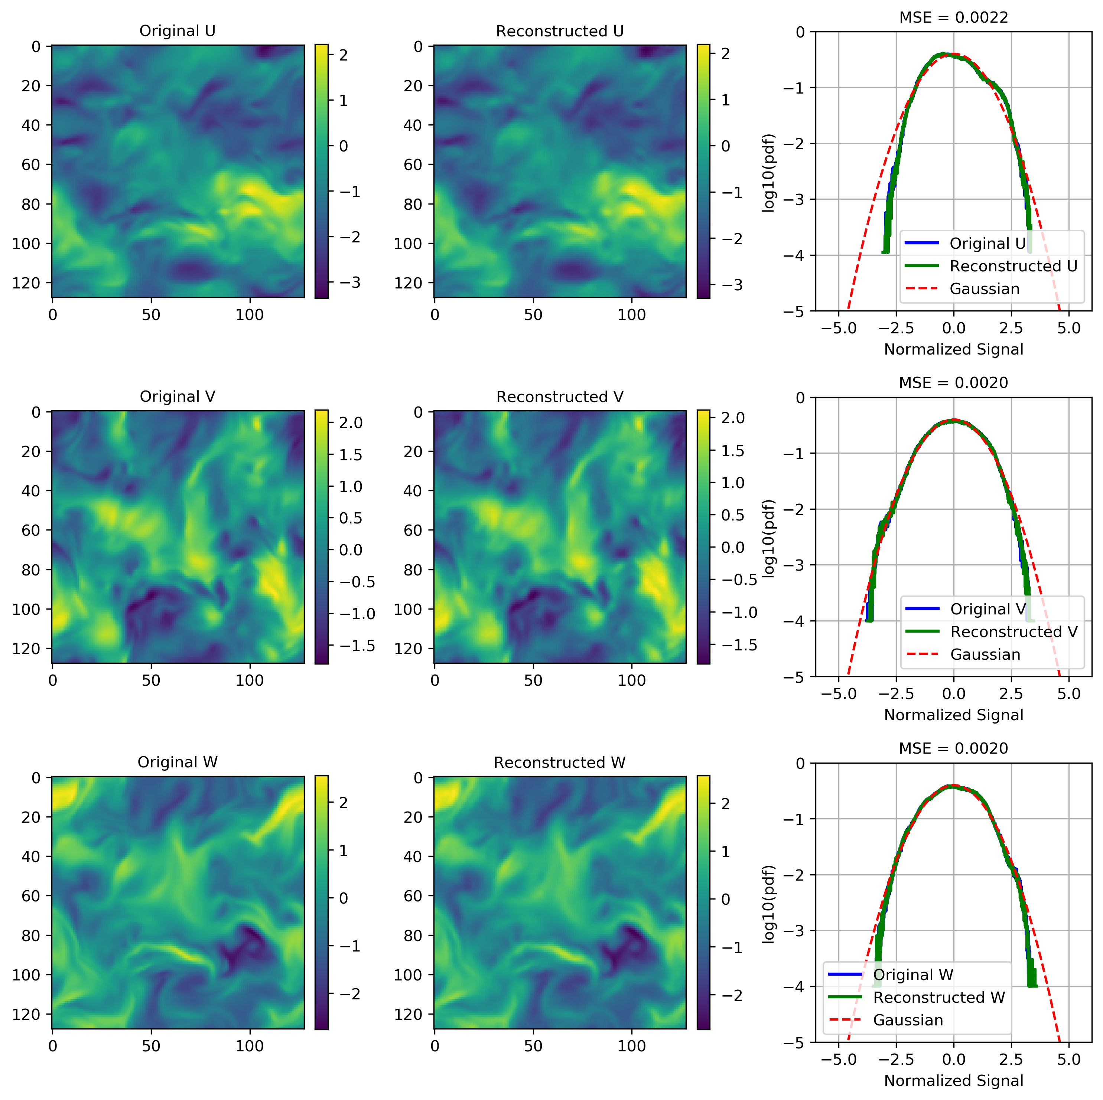
Smart Turbulence
Use VQ-VAE to first reduce 3D data (can be used in music and speech synthesis)
Add gradient constraint during training
Time series prediction on coded space

Slide 5
Preliminary Exam
Requirements
1) a written dissertation research proposal
2) an oral presentation and defense of this proposal to an approved five-member faculty committee.
The written dissertation research proposal should consist of a 10-page (maximum) report plus appendices providing additional supporting information as well as an anticipated timeline for completion of all PhD degree requirements.
The oral presentation, approximately 45 minutes with extra time allotted for questions posed by the committee throughout and after the presentation, should reflect the contents of the report.

Slide 6
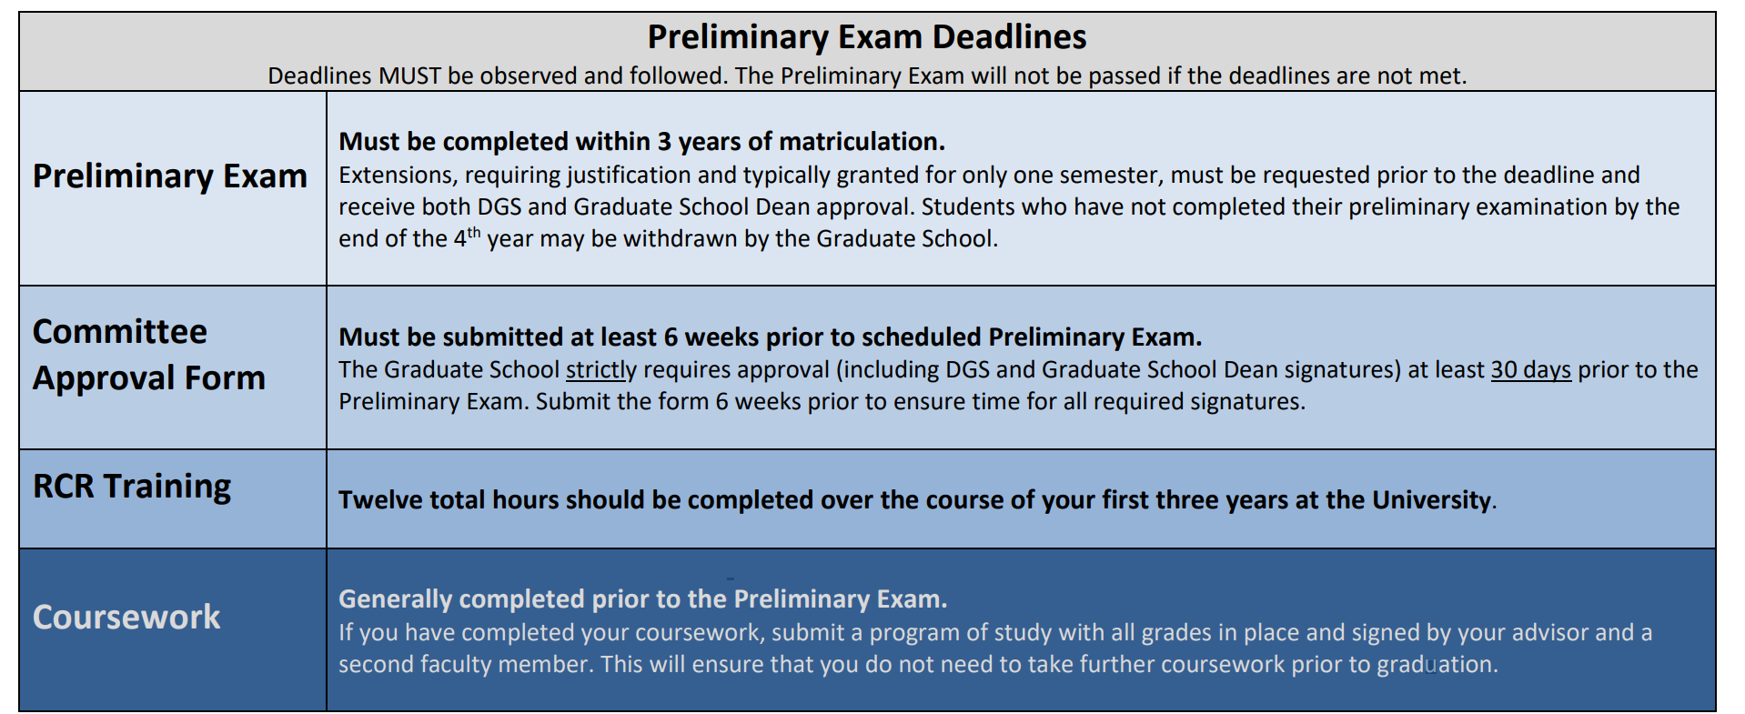
Preliminary Exam
Requirements

Slide 7
Preliminary Exam
Committee
The Graduate School strictly requires approval (including DGS and Graduate School Dean signatures) at least 30 days prior to the Preliminary Exam. Submit the form 6 weeks prior to ensure time for all required signatures.
Five members
Academic advisor
At least one committee member (the Minor Area Representative (MAR)) must be from a department or ECE field outside of the student’s major research area
Potential candidates:
Prof. Lawrence Carin
Prof. Guillermo Sapiro
Prof. Jeffrey Krolik
Prof. Robert Calderbank
Prof. Henry D. Pfister
…

Slide 8
Preliminary Exam
Committee
The Graduate School strictly requires approval (including DGS and Graduate School Dean signatures) at least 30 days prior to the Preliminary Exam. Submit the form 6 weeks prior to ensure time for all required signatures.
Five members
Academic advisor
At least one committee member (the Minor Area Representative (MAR)) must be from a department or ECE field outside of the student’s major research area
Potential candidates:
Prof. Lawrence Carin
Prof. Guillermo Sapiro
Prof. Jeffrey Krolik
Prof. Robert Calderbank
Prof. Henry D. Pfister
…

Slide 9
Preliminary Exam
Exam Details Form
Please enter your exam details at least three weeks prior to your exam here:
https://duke.qualtrics.com/jfe/form/SV_bygP2d2XkuLX1gp
I do not use Prelim Exam as MS Exam to earn MS degree

Slide 10
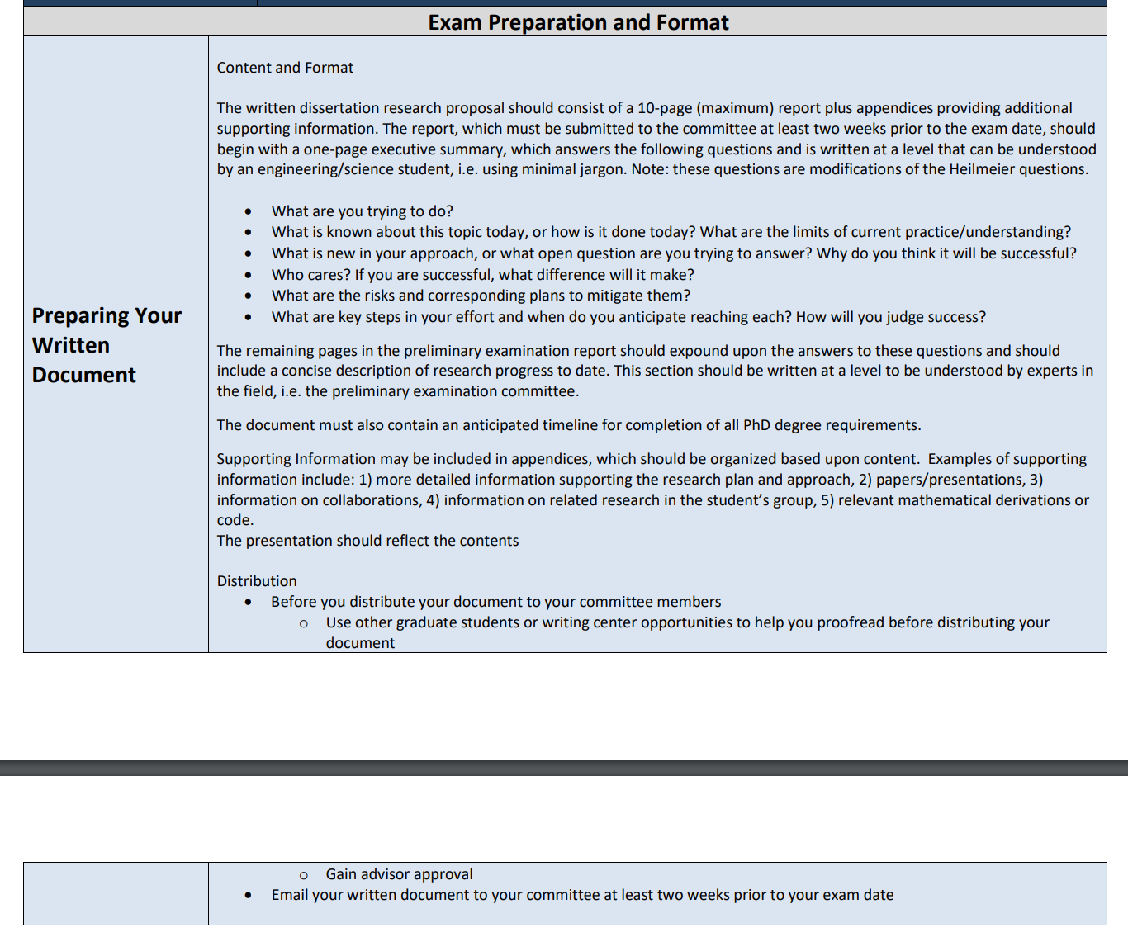
Preliminary Exam
Written Document

